Slide 1
ChemCorp Market & Product Analysis
Data-Driven Insights & Strategic Recommendations
Presented by: Shivangini Marjiwe

Slide 2
Business Problem Statement
Understanding the Market Segment
Lost customers led to a 10% revenue decline.
Increased competition with AI-driven cost efficiencies.
Management seeks insights to prevent further market share erosion.
Goal: Identify profitable segments, optimize investments, and suggest divestment areas.
Customer purchase preferences vary by industry.
Paper & Packaging contributes the highest revenue.
Biotechnology & Pharmaceuticals generate lower revenue.
Geographic hotspots: North Central, Pacific, South Atlantic regions.
Seasonal peaks: May & November show the highest revenue inflow.

Slide 3
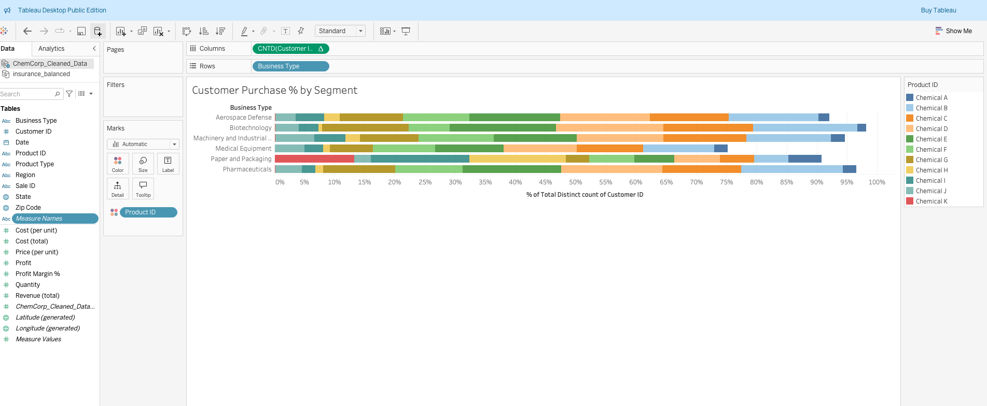
Customer Purchase % by Segment (Bar Chart)

Slide 4
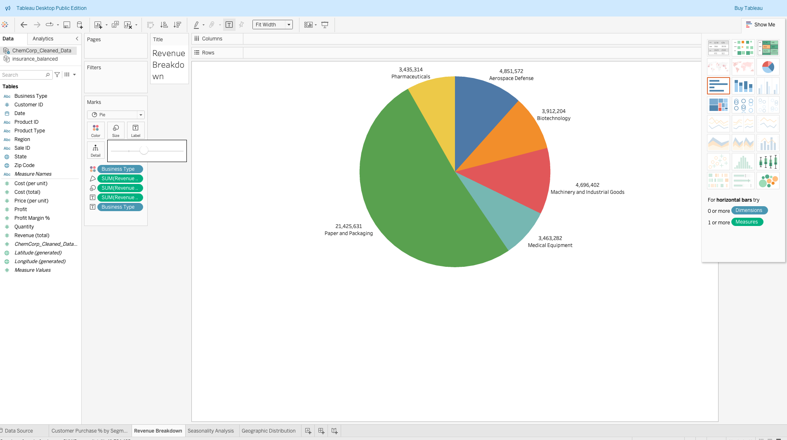
Revenue Breakdown Per Industry (Pie Chart)

Slide 5
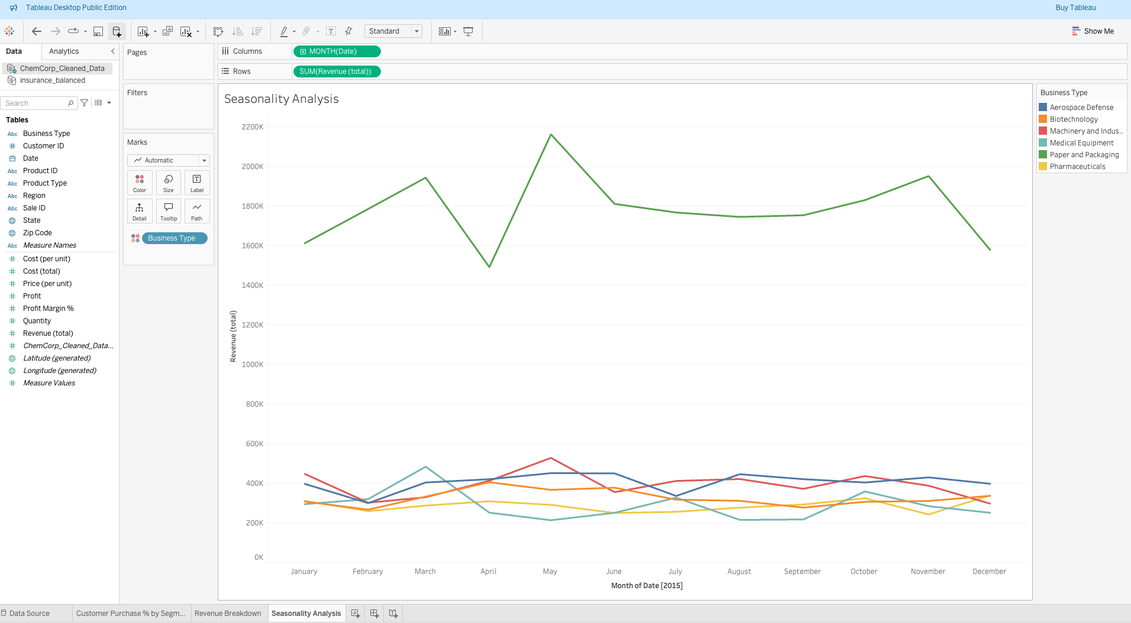
Seasonality Analysis (Line Chart)

Slide 6
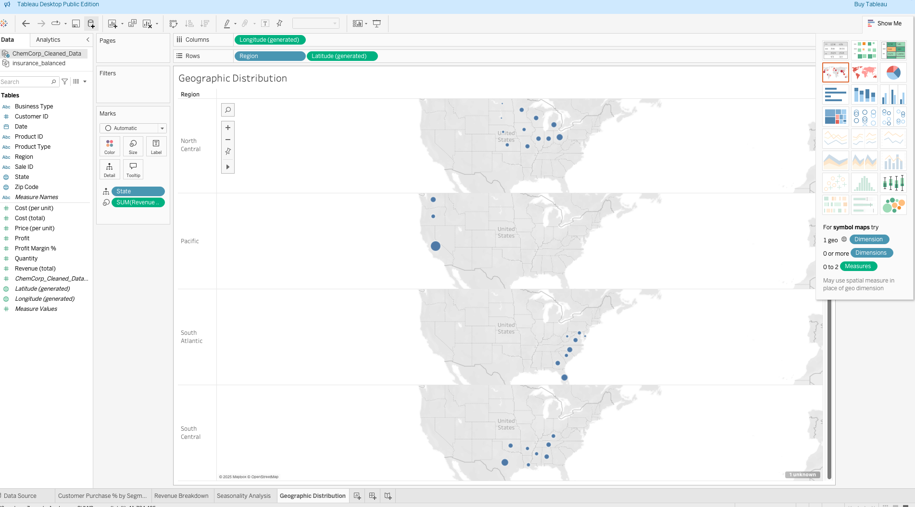
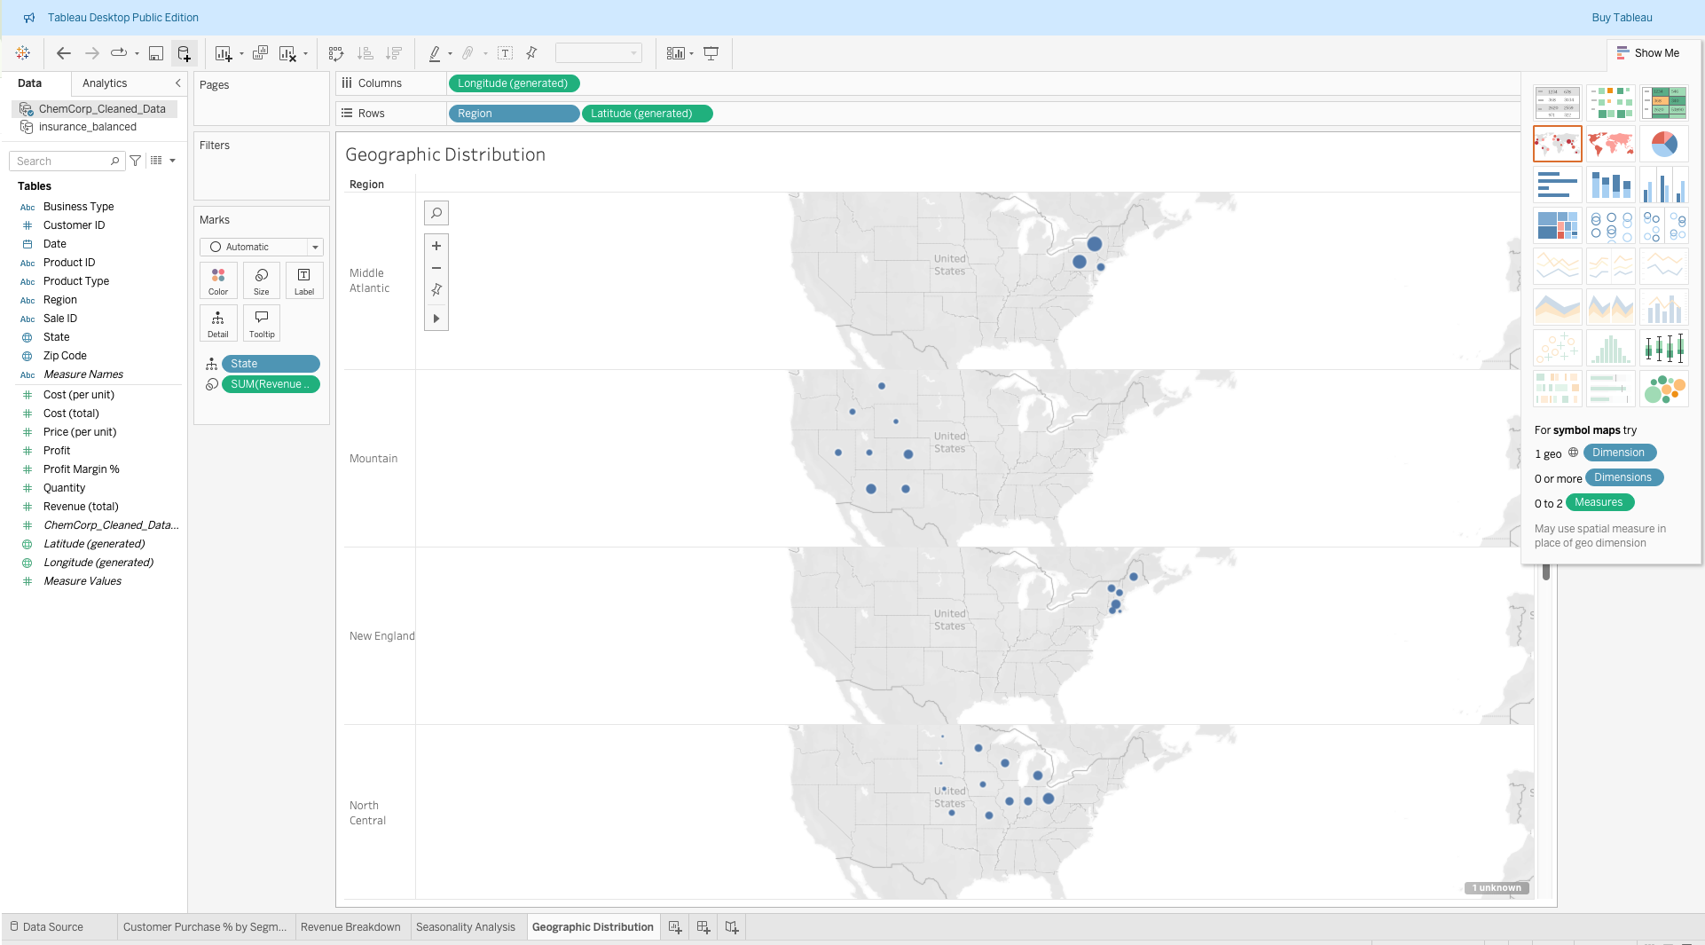
Geographic Distribution of Sales (Map)

Slide 7
Market Opportunity – Profitability & Growth
Industry Profitability:
Paper & Packaging is the most profitable industry.
Pharmaceuticals has the lowest profitability.
Profit Margin vs. Customer Count:
Paper & Packaging leads in both profit margin and customer count.
Medical Equipment struggles with both low customer count & profitability.
Most Profitable Products:
Chemical K is the highest revenue-generating product.
Chemicals A & J have the lowest profitability.

Slide 8
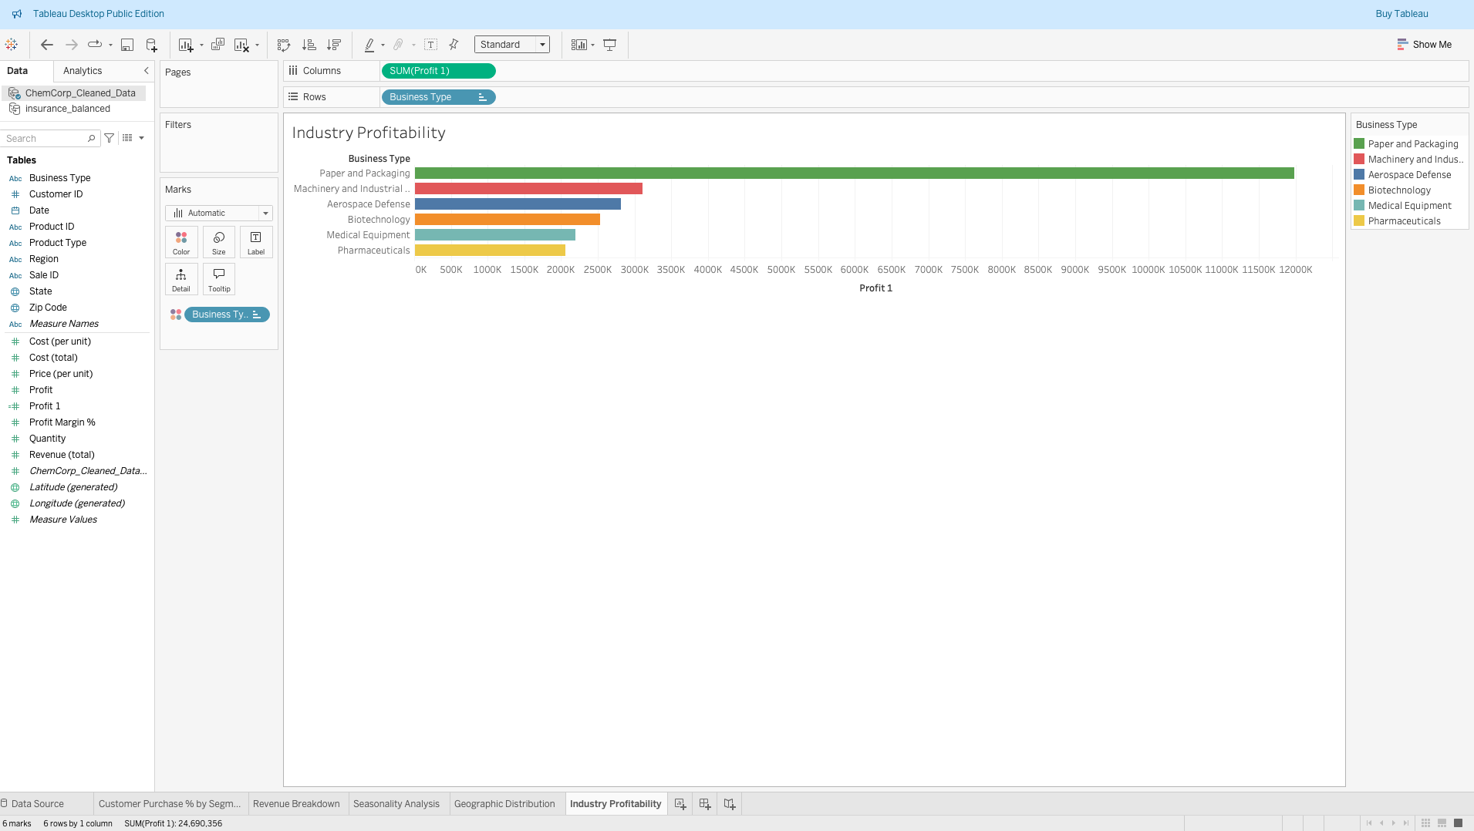
Industry Profitability (Bar Chart)

Slide 9
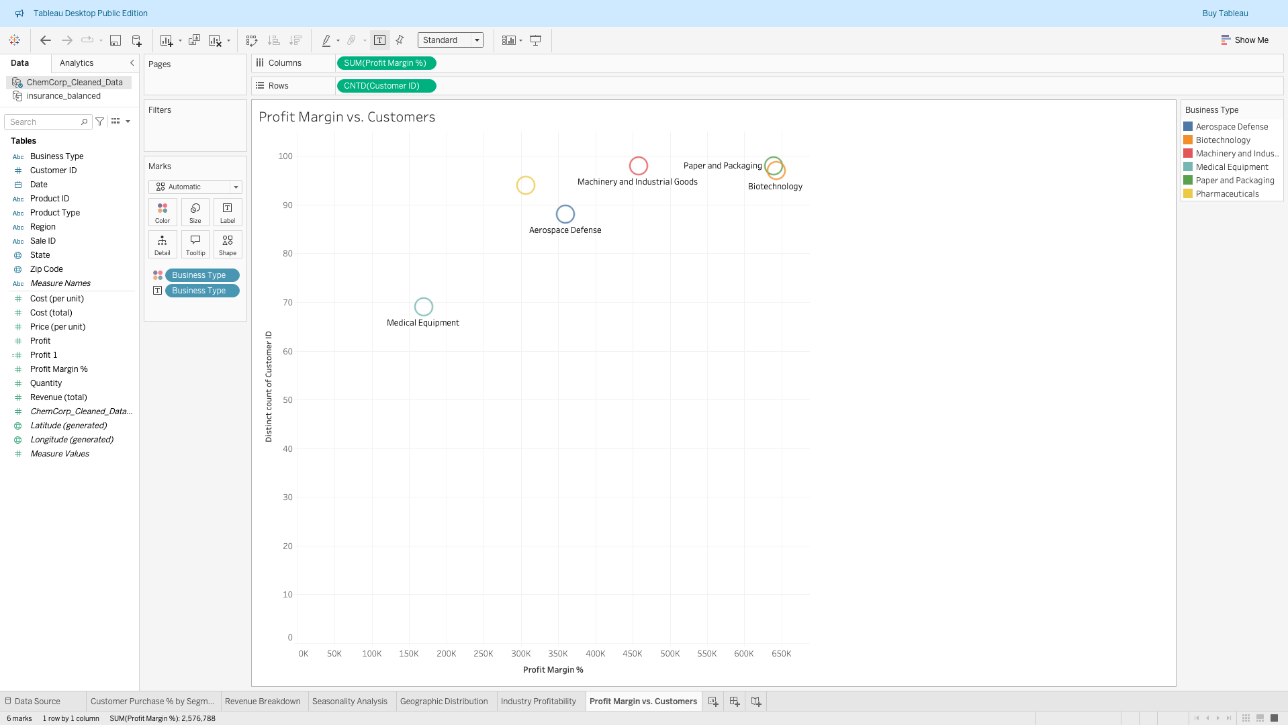
Profit Margin vs. Customer Count (Scatter Plot)

Slide 10
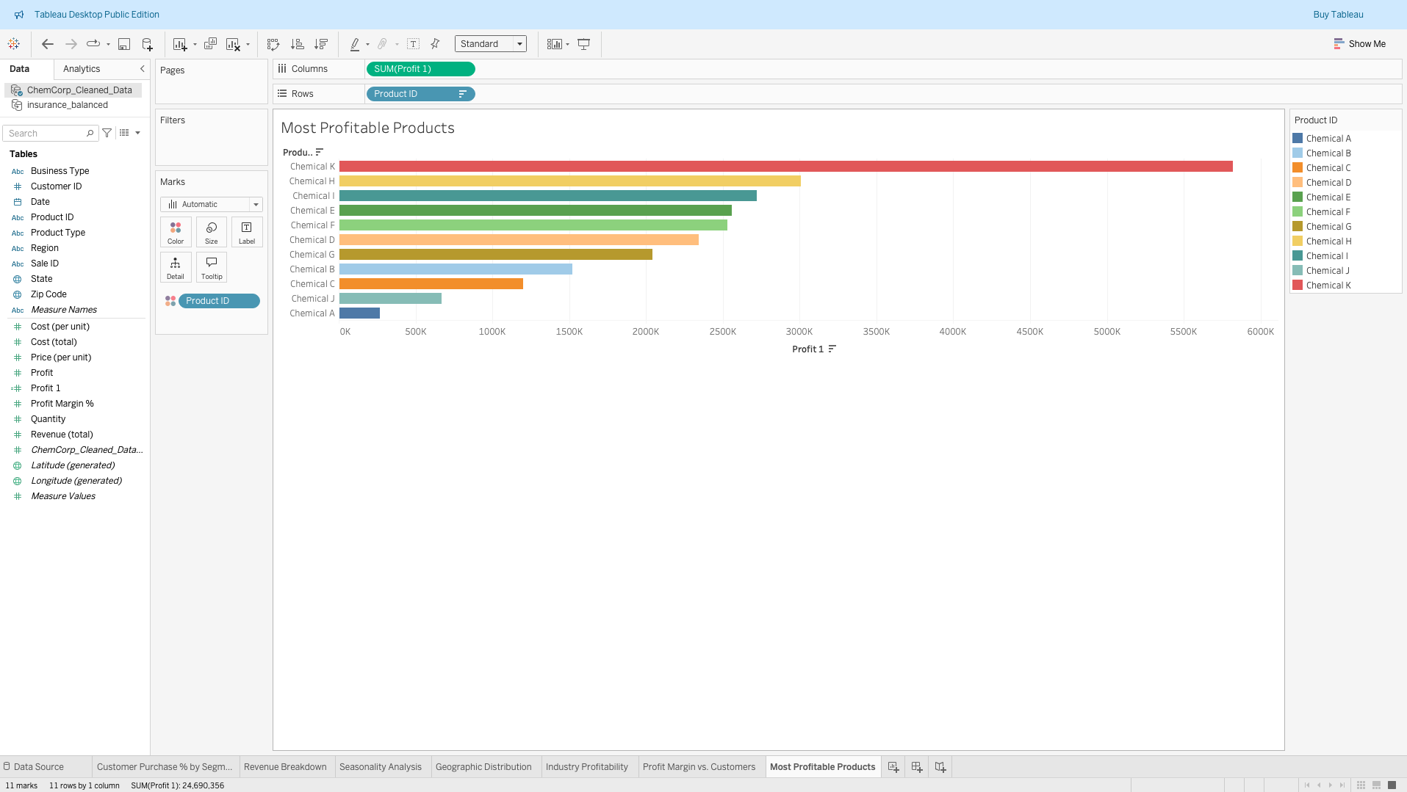
Most Profitable Products (Horizontal Bar Chart)

Slide 11
Product Divestment – Low-Profit & Low-Sales Products
Low-Profit Industries:
Pharmaceuticals and Medical Equipment struggle to generate profit.
Several chemicals have low-profit margins across industries.
Lowest Sales Products:
Chemicals A & J have the lowest sales volumes.
Chemical K & H are best-sellers.

Slide 12
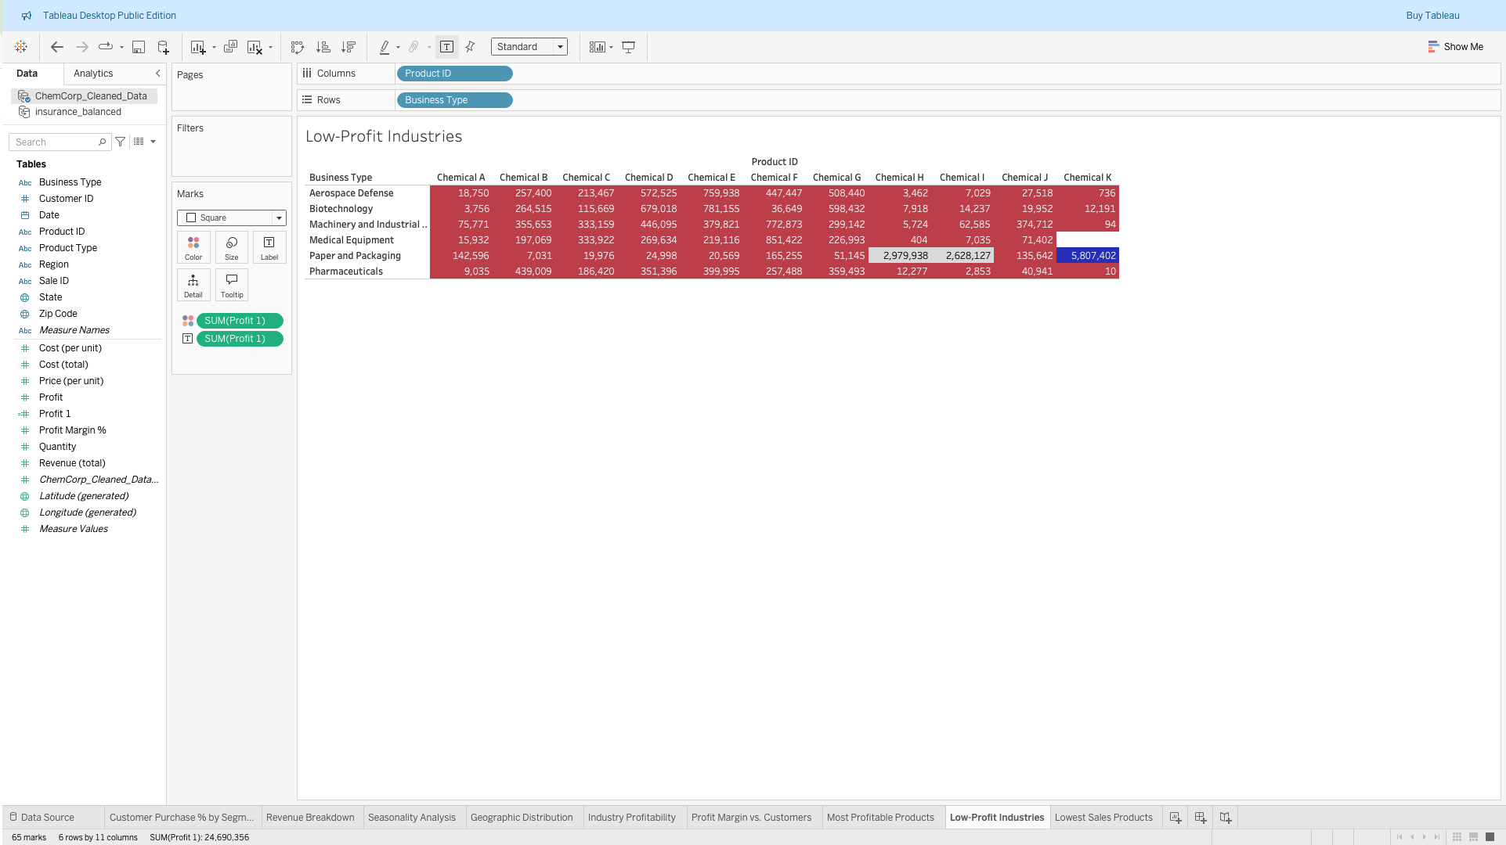
Low-Profit Industries (Heatmap)

Slide 13
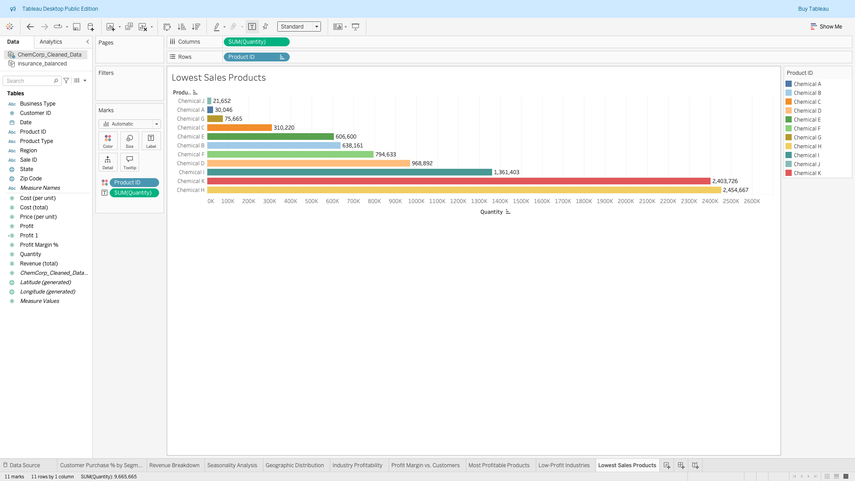
Products with Lowest Sales (Bar Chart)

Slide 14
Strategic Recommendations
Invest in High-Profit, High-Sales Segments
Expand focus on Paper & Packaging, Machinery & Industrial Goods.
Increase marketing and production for Chemicals K, H, and F.
Reassess or Divest from Low-Profit Areas
Consider exiting or reducing investment in Pharmaceuticals & Medical Equipment.
Phase out Chemicals A & J due to low sales & profitability.
Optimize Pricing & Cost Efficiency
Review cost structures in Biotechnology & Aerospace Defense to improve profit margins.
Implement dynamic pricing strategies to boost revenue.
Expand Geographic Reach
Strengthen presence in North Central & South Atlantic regions.
Investigate sales barriers in low-performing states.
Enhance Customer Retention & Acquisition
Strengthen relationships with Paper & Packaging customers.
Develop competitive pricing & service models to capture more market share.

Slide 15
Conclusion
ChemCorp must scale high-performing segments and discontinue underperforming areas to sustain profitability.
By executing these strategies, ChemCorp will regain market share, improve profitability, and ensure long-term success.

